Slide 1
Advanced Excel
Splitting Columns into Multiple Columns
Formatting Zip Codes

Slide 2
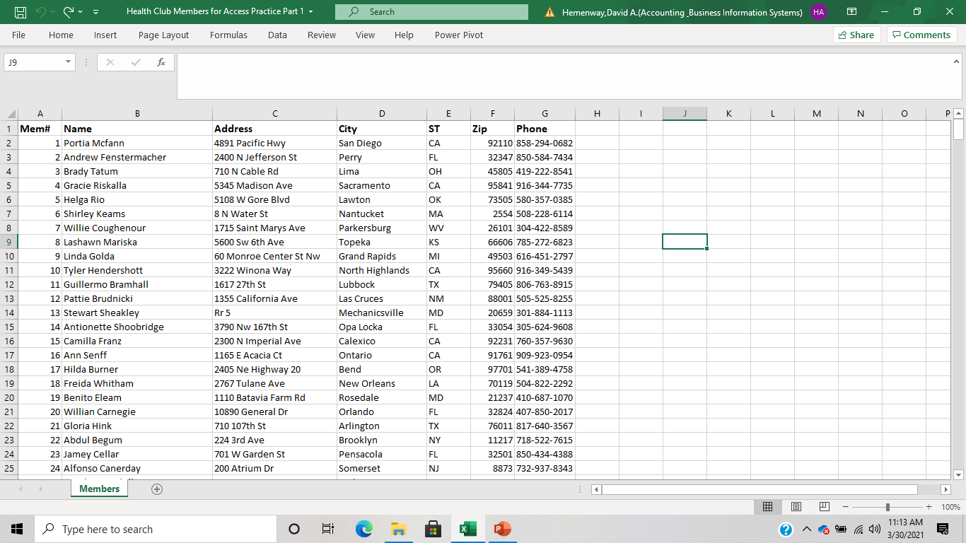
Pull up Health Care Members for Access Practice – Part 1

Slide 3
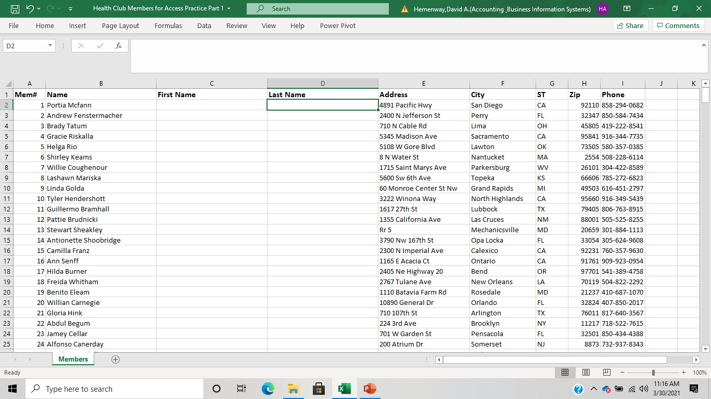
Add two columns next to the name column and name them First Name and Last Name

Slide 4
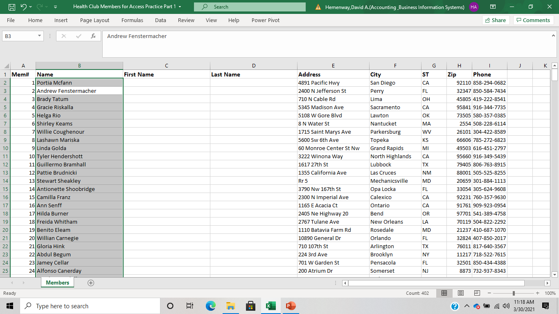
Highlight the column you want to split

Slide 5
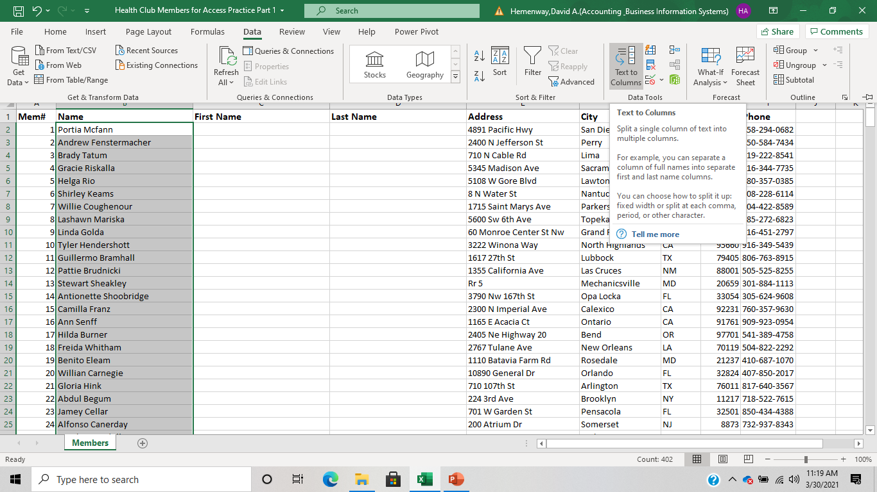
Select Data – Text to Columns

Slide 6
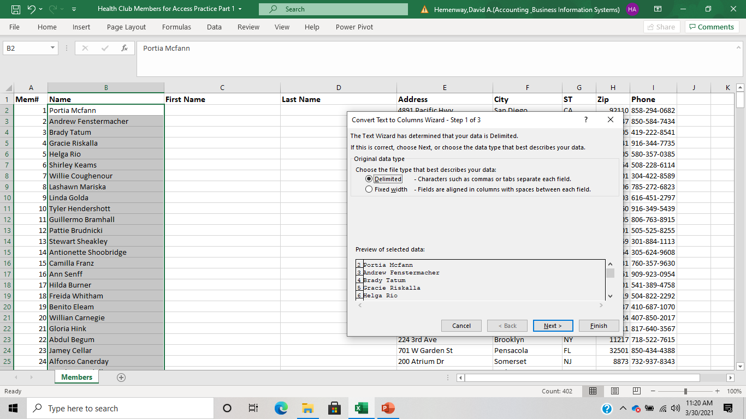
Select the Delimited option and select Next

Slide 7
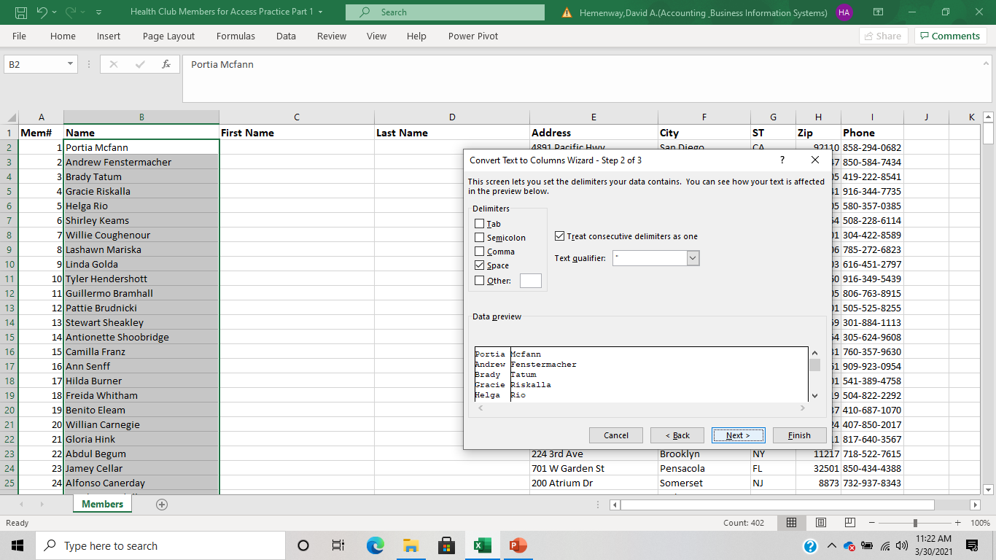
Select the space delimiter and select Next

Slide 8
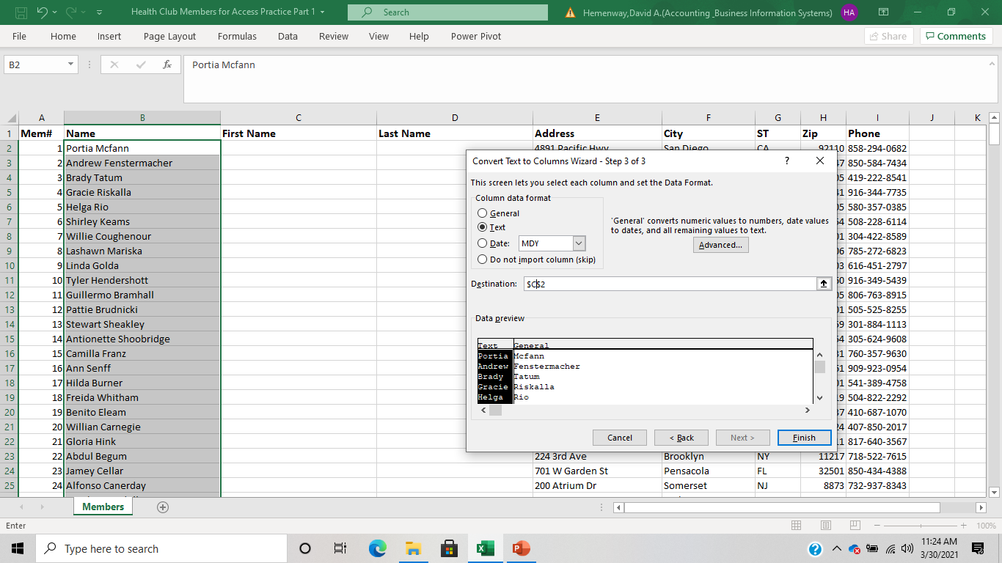
Select Text in the Column data format for both names and $C$2 as the Destination

Slide 9
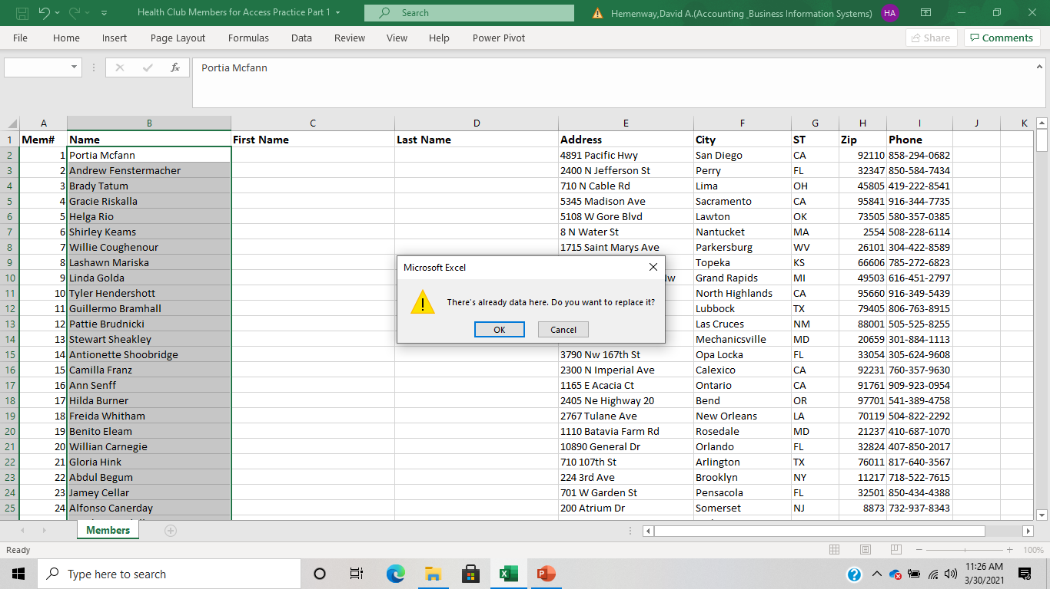
Check OK when you get this message

Slide 10
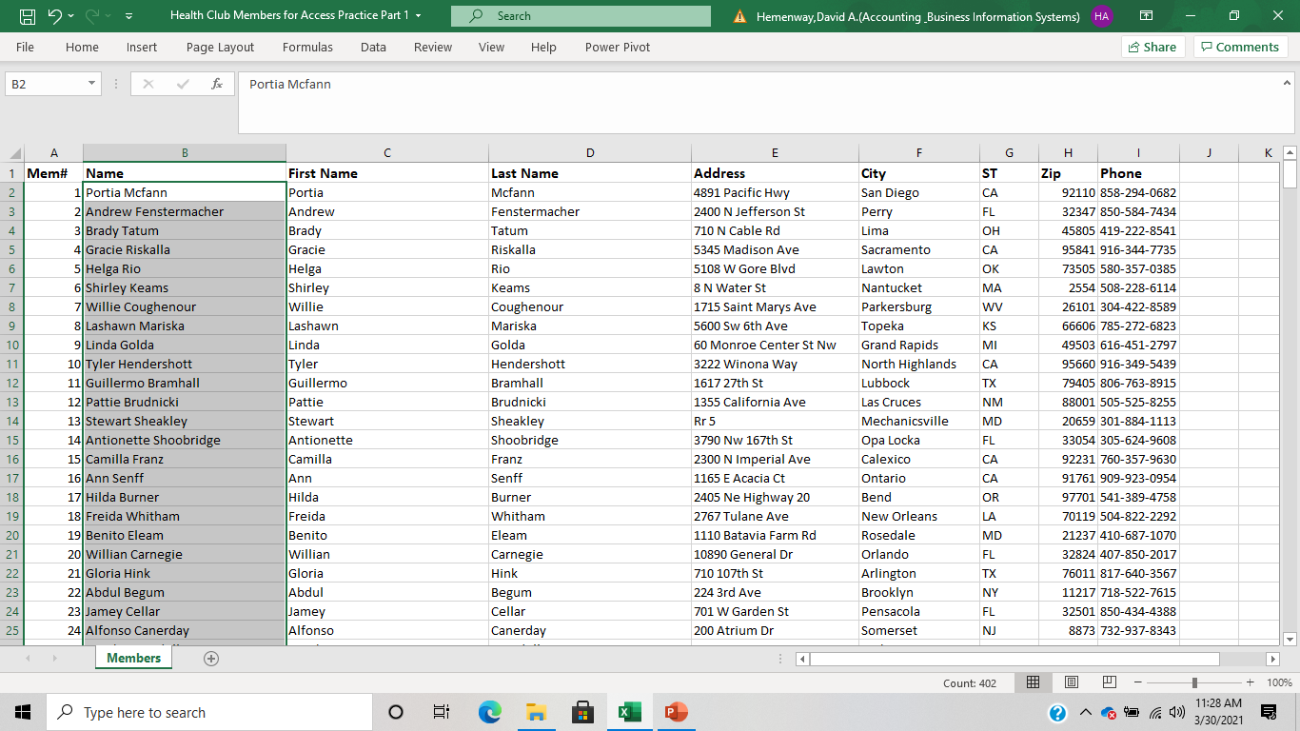
And Presto! You have split the name variable into two variables.

Slide 11
Should you keep the original name after verifying the column was split properly?

Slide 12
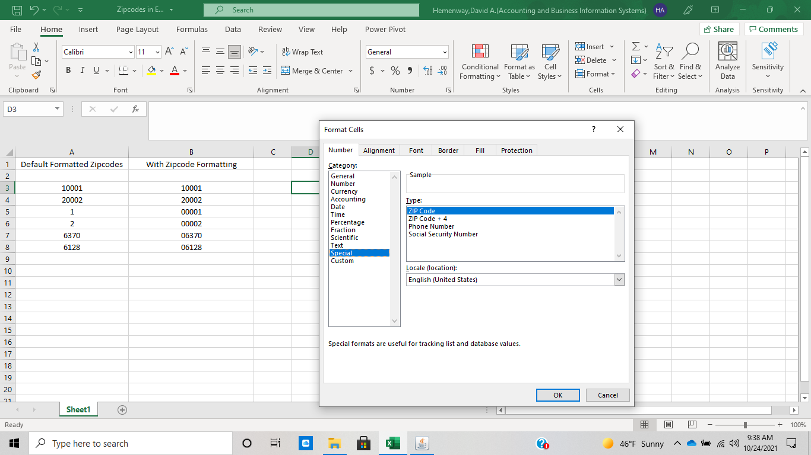
Formatting Zip Codes

Slide 13
Now rebuild your Health Club Members Database

Slide 14
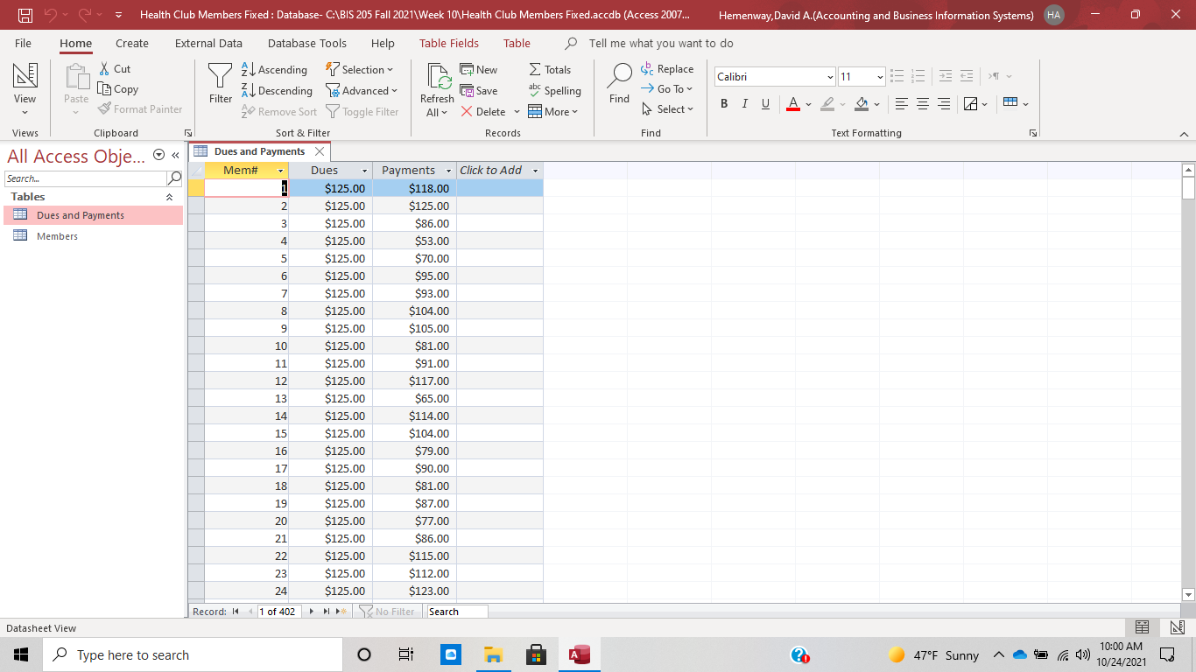
Dues and Payments in Currency

